Slide 1


Module 6:
Design Patterns for Pages with Selenium WebDriver

Slide 2
AGENDA
1
What is pattern?
2
Page object pattern.
3
Demo.

Slide 3
PART 1
What is PATTERN?

Slide 4

WHAT IS PATTERN?
Design patterns represent the best practices used by experienced object-oriented software developers.
Design patterns are solutions to general problems that software developers faced during software development. These solutions were obtained by trial and error by numerous software developers over quite a substantial period of time.

Slide 5
DESIGN PATTERN IS A SOLUTION
Advantages of design patterns:
They provide the solutions that help to define the system architecture.
They capture the software engineering experiences.
They provide transparency to the design of an application.
They are language neutral and so can be applied to any language that supports object-orientation.
They aid communication by the very fact that they are well documented and can be researched if that is not the case.
They have a proven track record as they are already widely used and thus reduce the technical risk to the project.
They are highly flexible and can be used in practically any type of application or domain.
Design patterns don’t guarantee an absolute solution to a problem. They provide clarity to the system architecture and the possibility of building a better system.

Slide 6
PART 2
PAGE OBJECT PATTERN

Slide 7
WHAT WRONG WITH CODE?
describe('angularjs homepage', function() { it('should greet the named user', function() { browser.get('http://www.angularjs.org'); element(by.model('yourName')).sendKeys('Julie'); var greeting = element(by.binding('yourName')); expect(greeting.getText()).toEqual('Hello Julie!'); }); describe('todo list', function() { var todoList; beforeEach(function () { browser.get('http://www.angularjs.org'); todoList = element.all(by.repeater('todo in todos')); }); it('should list todos', function () { expect(todoList.count()).toEqual(2); expect(todoList.get(1).getText()).toEqual('build an angular app'); }); it('should add a todo', function () { var addTodo = element(by.model('todoText')); var addButton = element(by.css('[value="add"]')); addTodo.sendKeys('write a protractor test'); addButton.click(); expect(todoList.count()).toEqual(3); expect(todoList.get(2).getText()).toEqual('write a protractor test'); }); });

Slide 8
PAGE OBJECT. WHAT IS IT?
AS PER SELENIUM GUYS:
Page Object is a Design Pattern which has become popular in test automation for enhancing test maintenance and reducing code duplication. A page object is an object-oriented class that serves as an interface to a page of your AUT. The tests then use the methods of this page object class whenever they need to interact with that page of the UI. The benefit is that if the UI changes for the page, the tests themselves don’t need to change, only the code within the page object needs to change. Subsequently all changes to support that new UI are located in one place.
Page Objects – most popular and well-designed pattern for Selenium project.
Object-oriented class.
Interface to a page of your AUT (tests interact with its methods instead of the UI)
SUM UP:

Slide 9
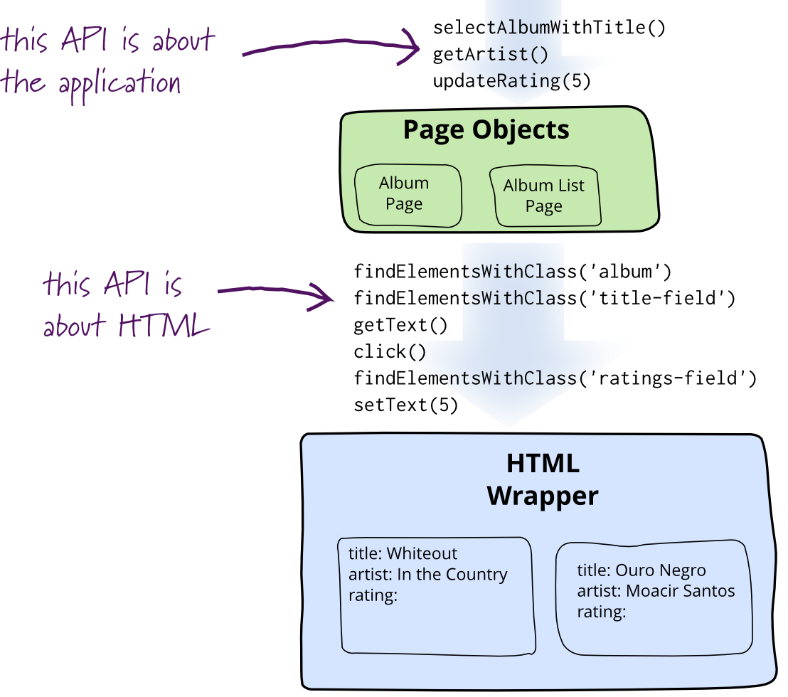
PAGE OBJECT.
If you have WebDriver APIs in your test methods, You're Doing It Wrong. -- Simon Stewart.

Slide 10
PAGE OBJECT.
PO
Page Class (Screen)
WebElements
Methods
Web application made of Web pages
Every Web page contains it’s own elements (HTML buttons, text inputs, menus etc.)
Page provides as different services (methods)

Slide 11
USING PAGE OBJECTS TO ORGANIZE TESTS
WITHOUT PAGE OBJECTS
WITH PAGEOBJECTS
describe('angularjs homepage', function() { it('should greet the named user', function() { browser.get('http://www.angularjs.org'); element(by.model('yourName')).sendKeys('Julie'); var greeting = element(by.binding('yourName')); expect(greeting.getText()).toEqual('Hello Julie!'); }); });
var AngularHomepage = function() { var nameInput = element(by.model('yourName')); var greeting = element(by.binding('yourName')); this.get = function() { browser.get('http://www.angularjs.org'); }; this.setName = function(name) { nameInput.sendKeys(name); }; this.getGreeting = function() { return greeting.getText(); }; }; describe('angularjs homepage', function() { it('should greet the named user', function() { var angularHomepage = new AngularHomepage(); angularHomepage.get(); angularHomepage.setName('Julie'); expect(angularHomepage.getGreeting()).toEqual('Hello Julie!'); }); });

Slide 12
PAGE OBJECT. ADVANTAGES
After implementing the Page Objects pattern, we end up with a framework that describes the application from business point of view. Each action performed by a test using this framework should be easy to comprehend to anyone in the given field. That is to say, a test written for an accounting system that is heavy on the field’s jargon might not be easy to comprehend to the laymen; however, anyone with basic knowledge of the field should understand the intentions of each action.
Page Object pattern helps to test the desired behavior of the application using its DSL
This pattern helps in enhancing the tests, making them highly maintainable, reducing the code duplication, building a layer of abstraction, and hiding the inner implementation from tests.
A well-implemented and rigid Page Objects framework has one and only way to accomplish any action. This prevents duplicate implementation of the same methods.
Since each Page Object is made from multiple smaller objects, such as header section or login form, the smaller objects can be shared between multiple Page Objects.

Slide 13
PAGE OBJECT. DISADVANTAGES
Complexity is increased when using Page Objects framework. As the name implies, we can’t just write a simple procedural test, we need to create a framework.
Programming design patterns should be followed to make the code consistent and easy to understand. Otherwise, the framework quickly becomes muddled and complex to use and maintain.
As with any new tool, it is tempting to get carried away and use it everywhere. It’s tempting to implement a Page Objects framework on a test suite that only has 10 tests; this time could probably have been spent better improving existing code.

Slide 14
DEMO

Slide 15
RESOURCES ABOUT PAGE OBJECT
Official WebDriver definition:
http://www.seleniumhq.org/docs/06_test_design_considerations.jsp
Other resources:
http://martinfowler.com/bliki/PageObject.html
http://www.protractortest.org/#/page-objects
https://www.thoughtworks.com/insights/blog/using-page-objects-overcome-protractors-shortcomings

Slide 16
Thank you!

